Slide 1

Pharmacy Delivery System
Graduation Project – Digital Egypt Pioneers Initiative (DEPI)
Team Members: [Insert Team Member Names Here]
Technologies: C#, ASP.NET MVC, HTML, CSS, JavaScript, SQL Server

Slide 2

Project Overview
Our Pharmacy Delivery System is a comprehensive web-based application designed to modernize and streamline the process of online pharmacy services and medicine delivery.
Seamless Online Experience
Users can easily browse a wide range of products, upload prescriptions digitally, and request convenient home delivery.
Dual Interface Design
The system features distinct interfaces tailored for both the Customer and Pharmacy/Admin sides, ensuring optimal functionality for each user group.

Slide 3

Core Project Goals
Our primary objectives are to enhance the speed, accuracy, and accessibility of pharmacy services through digital transformation.
Fast & Accurate Delivery
Ensuring medicines reach customers swiftly and without errors.
Real-time Stock Management
Providing up-to-the-minute inventory control for pharmacies.
Superior User Experience
Crafting a clean, intuitive, and highly responsive user interface.
Enhanced Efficiency
Implementing fully digital processes to maximize operational efficiency.
Increased Accessibility
Making essential pharmacy services available from the comfort of home.

Slide 4

Comprehensive Project Scope
Our system encompasses a robust set of features designed to manage all aspects of a digital pharmacy.
Backend & Management
Frontend & Data
Admin Panel for comprehensive control
Responsive UI Design for desktop & mobile
Product CRUD (Create, Read, Update, Delete) functionality
Robust Database Design with ERD and relational integrity
Advanced Inventory Management & Stock Control
Efficient Checkout and Order Processing

Slide 5
Stakeholder Analysis
Understanding the diverse needs of each stakeholder was crucial in shaping our system's design and functionality.
Stakeholder
Role
Needs
Impact
Admin
Manages products & orders
Easy interface & accurate operations
High
Customer
Places orders
Fast, intuitive UI & correct product info
High
Delivery Staff
Delivers orders
Clear order details & addresses
Medium
Pharmacy Owner
Oversees business
Reports, sales and stock tracking
High
Developers
Build & maintain system
Clean code structure & stability
Medium

Slide 6







Customer Side Features
The customer interface is designed for convenience, providing a seamless journey from browsing to order tracking.
Account Management
Secure Register & Login functionality.
Product Discovery
Browse medicines & health products with ease.
Advanced Search
Robust Search & Filter options for quick product finding.
Prescription Upload
Conveniently Upload medical prescriptions directly.
Shopping & Checkout
Intuitive Add to Cart and Checkout process.
Flexible Payments
Choose between Cash on Delivery or Online Payment.
Order Tracking
Real-time tracking of order status.

Slide 7
Pharmacy / Admin Side Features
The administrative interface provides comprehensive tools for efficient pharmacy operations and order fulfillment.
1
2
Medicine Management
Product Detailing
Add, Edit, and Delete medicine entries.
Manage product images, prices, discounts, and quantities.
3
4
Prescription Review
Order Processing
View uploaded prescriptions from customers.
Approve and efficiently process incoming orders.
5
6
Delivery Assignment
Status Updates
Assign orders to specific delivery runs or riders.
Update delivery and overall order status in real-time.

Slide 8

Database Design: Main Entities
Our relational database is structured around key entities to ensure data integrity and efficient operations.
Product
Order
ProId (PK)
OrderId (PK)
Name, Price, Quantity
CustomerId (FK)
Description, ImageUrl
Total, Date, Status
Brand, DrugType, Dosage
PharmId (FK)
OrderItems
ItemId (PK)
OrderId (FK)
ProductId (FK)
Qty, Price
Additional Tables: Customer, Pharmacy, Payment, DeliveryRun, QrConfirmation, and more contribute to the system's full functionality.

Slide 9
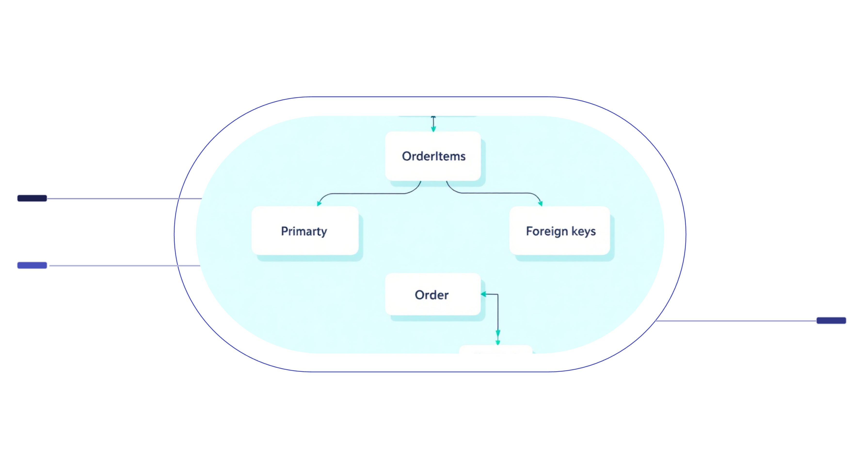
ERD: Relationship Model
Visualizing the connections between our core database entities is key to understanding data flow.
Product
PK: product_id; name; price
OrderItems
PK: order_item_id; FK: product_id, order_id; qty
Order
PK: order_id; customer_id; total
Key Relationships: One order can contain many items. Each item links directly to exactly one product, ensuring precise inventory and order details.

Slide 10

Architecture & Technologies
Our system is built on a robust and scalable architecture, leveraging modern web development frameworks and languages.
ASP.NET MVC Pattern
Ensuring clear separation of Model, View, and Controller for organized development.
C# Backend Logic
Powering the server-side with strong, object-oriented programming.
SQL Server Database
A reliable relational database management system for data storage.
Frontend Technologies
HTML, CSS, and JavaScript for a dynamic and interactive user interface.
Frameworks & Layers: We utilize Entity Framework for data access, along with a well-defined Business Layer featuring managers (e.g., ProductManager, OrderManager) for modularity.

